Slide 1


9 Inverse Problems & Deep Learning: Applications
Leon Herrmann
Stefan Kollmannsberger
Chair of Data Engineering in Construction
Bauhaus-Universität Weimar
Deep Learning in Computational Mechanics – an introductory course, Herrmann et al. 2025
website
book
Notes:
generated with https://www.the-qrcode-generator.com/

Slide 2
Contents
9 Inverse Problems
9.1 Basic Methodology
9.1.1 Physics-Informed Neural Networks
9.1.2 Iterative Forward Solvers
9.1.3 Data-Driven Solvers
9.2 Ultrasonic Nondestructive Testing
9.2.1 Acoustic Wave Equation
9.2.3 Physics-Informed Neural Networks
9.2.4 Iterative Forward Solver (with Neural Network Ansatz)
9.2.5 Data-Driven Solver & Transfer Learning
9.3 Topology Optimization
9.3.3 Iterative Forward Solver with Neural Network Ansatz (Compliance & Acoustic Optimization)
10 Methodological Overview of Deep Learning in Computational Mechanics

Slide 3
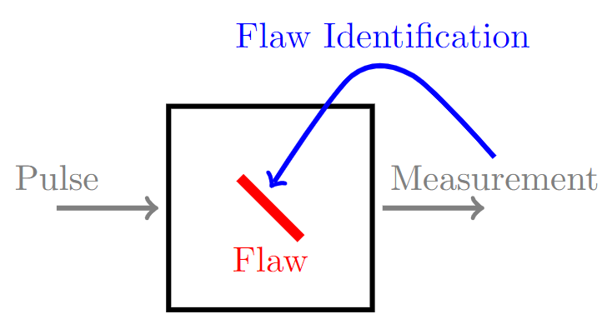
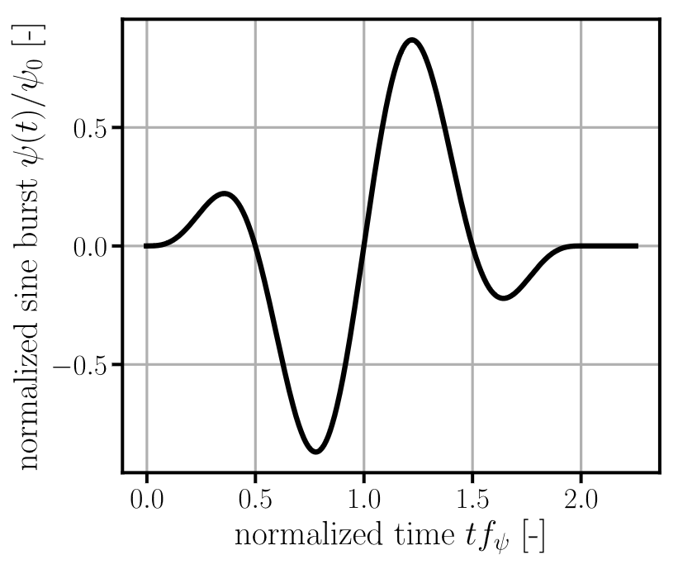
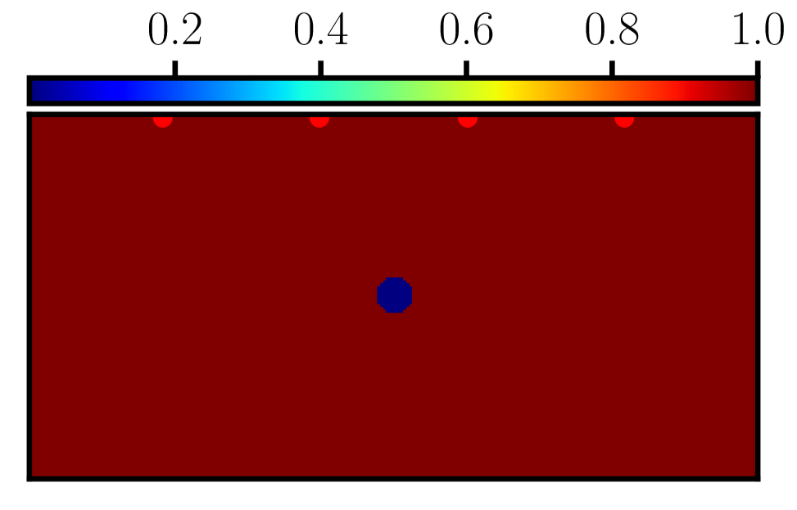
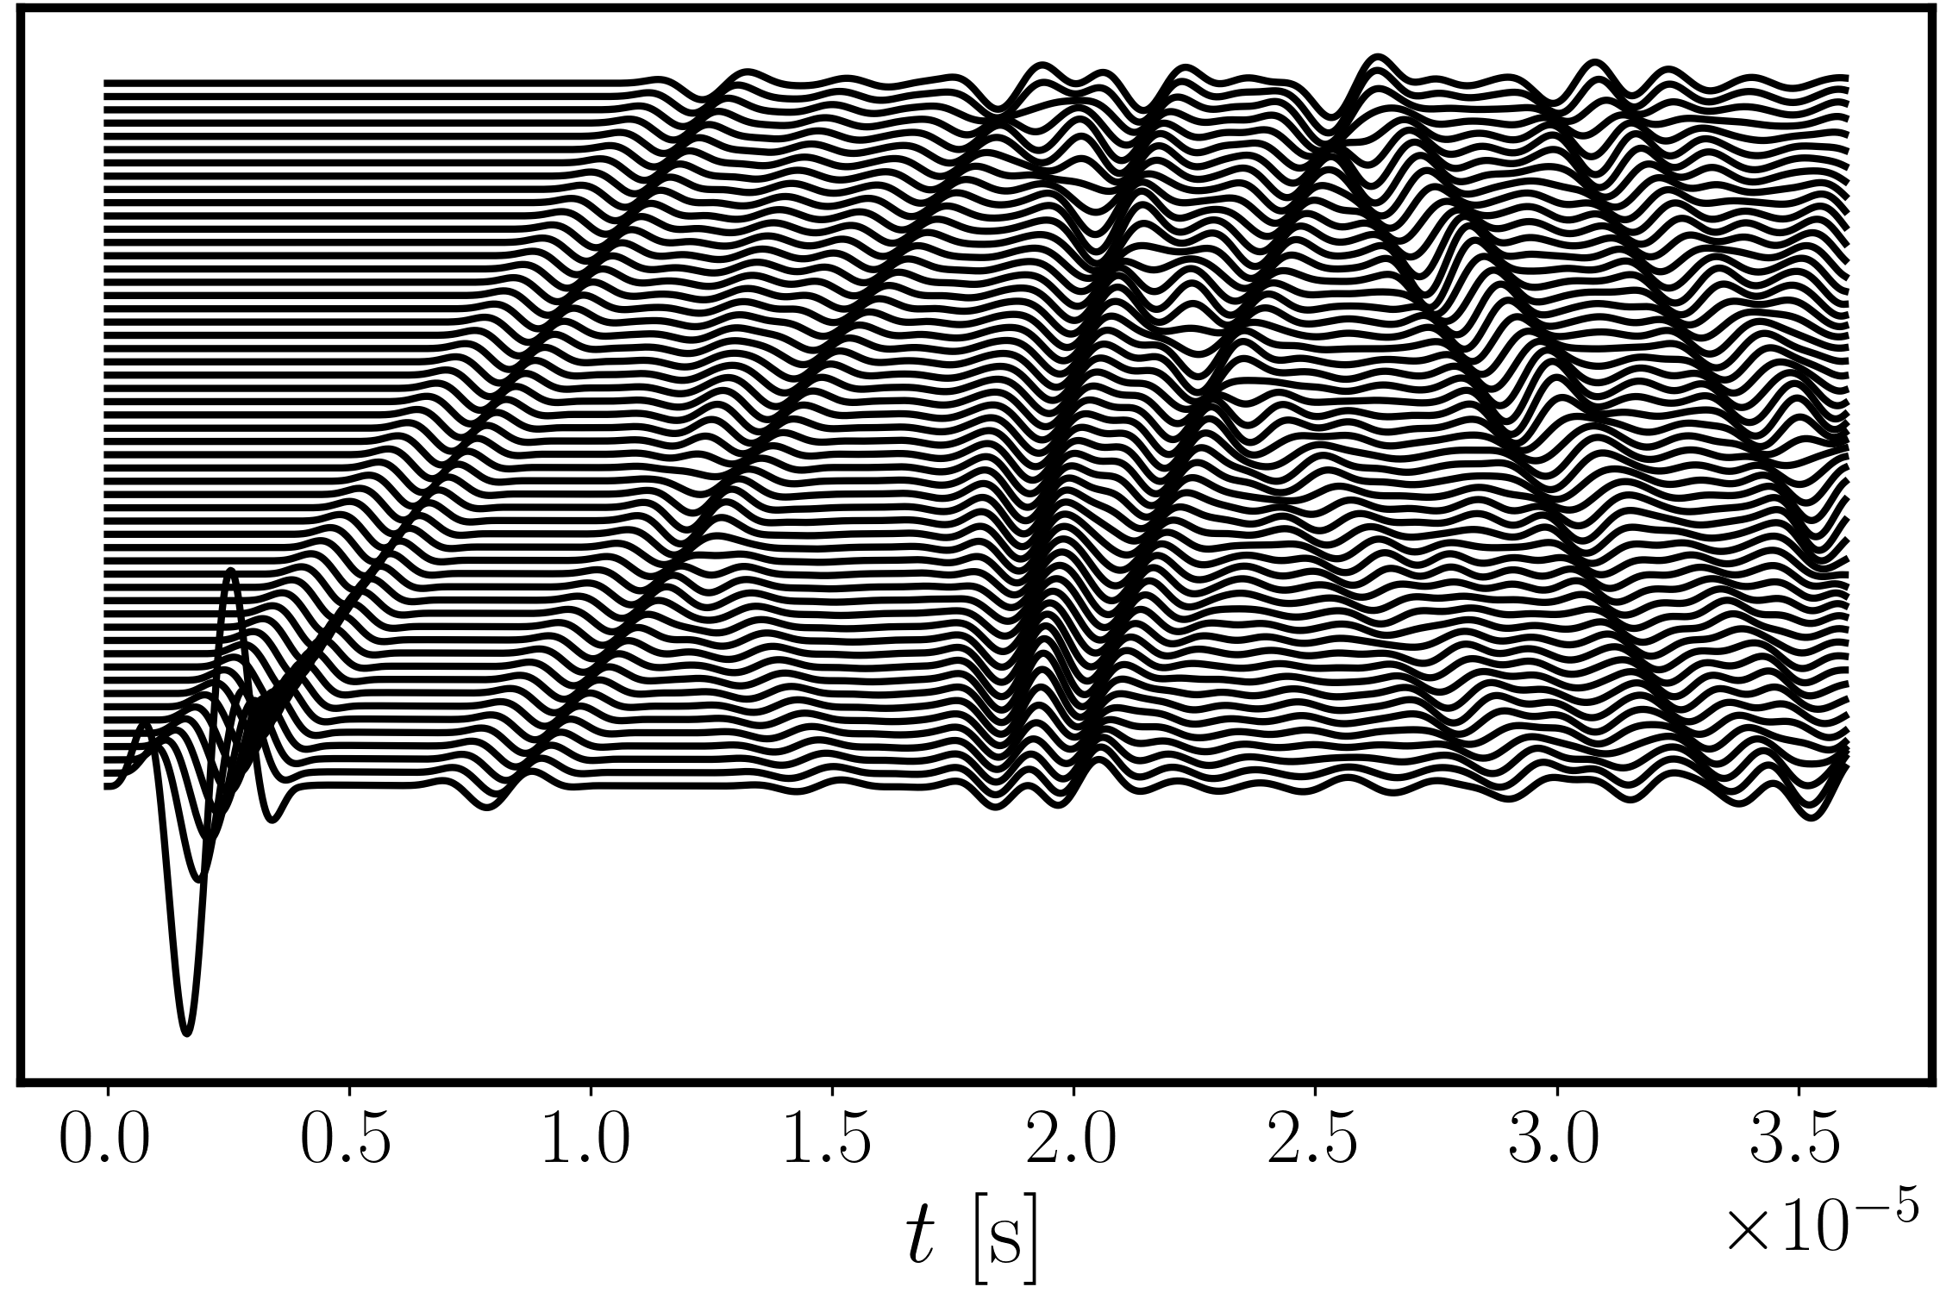
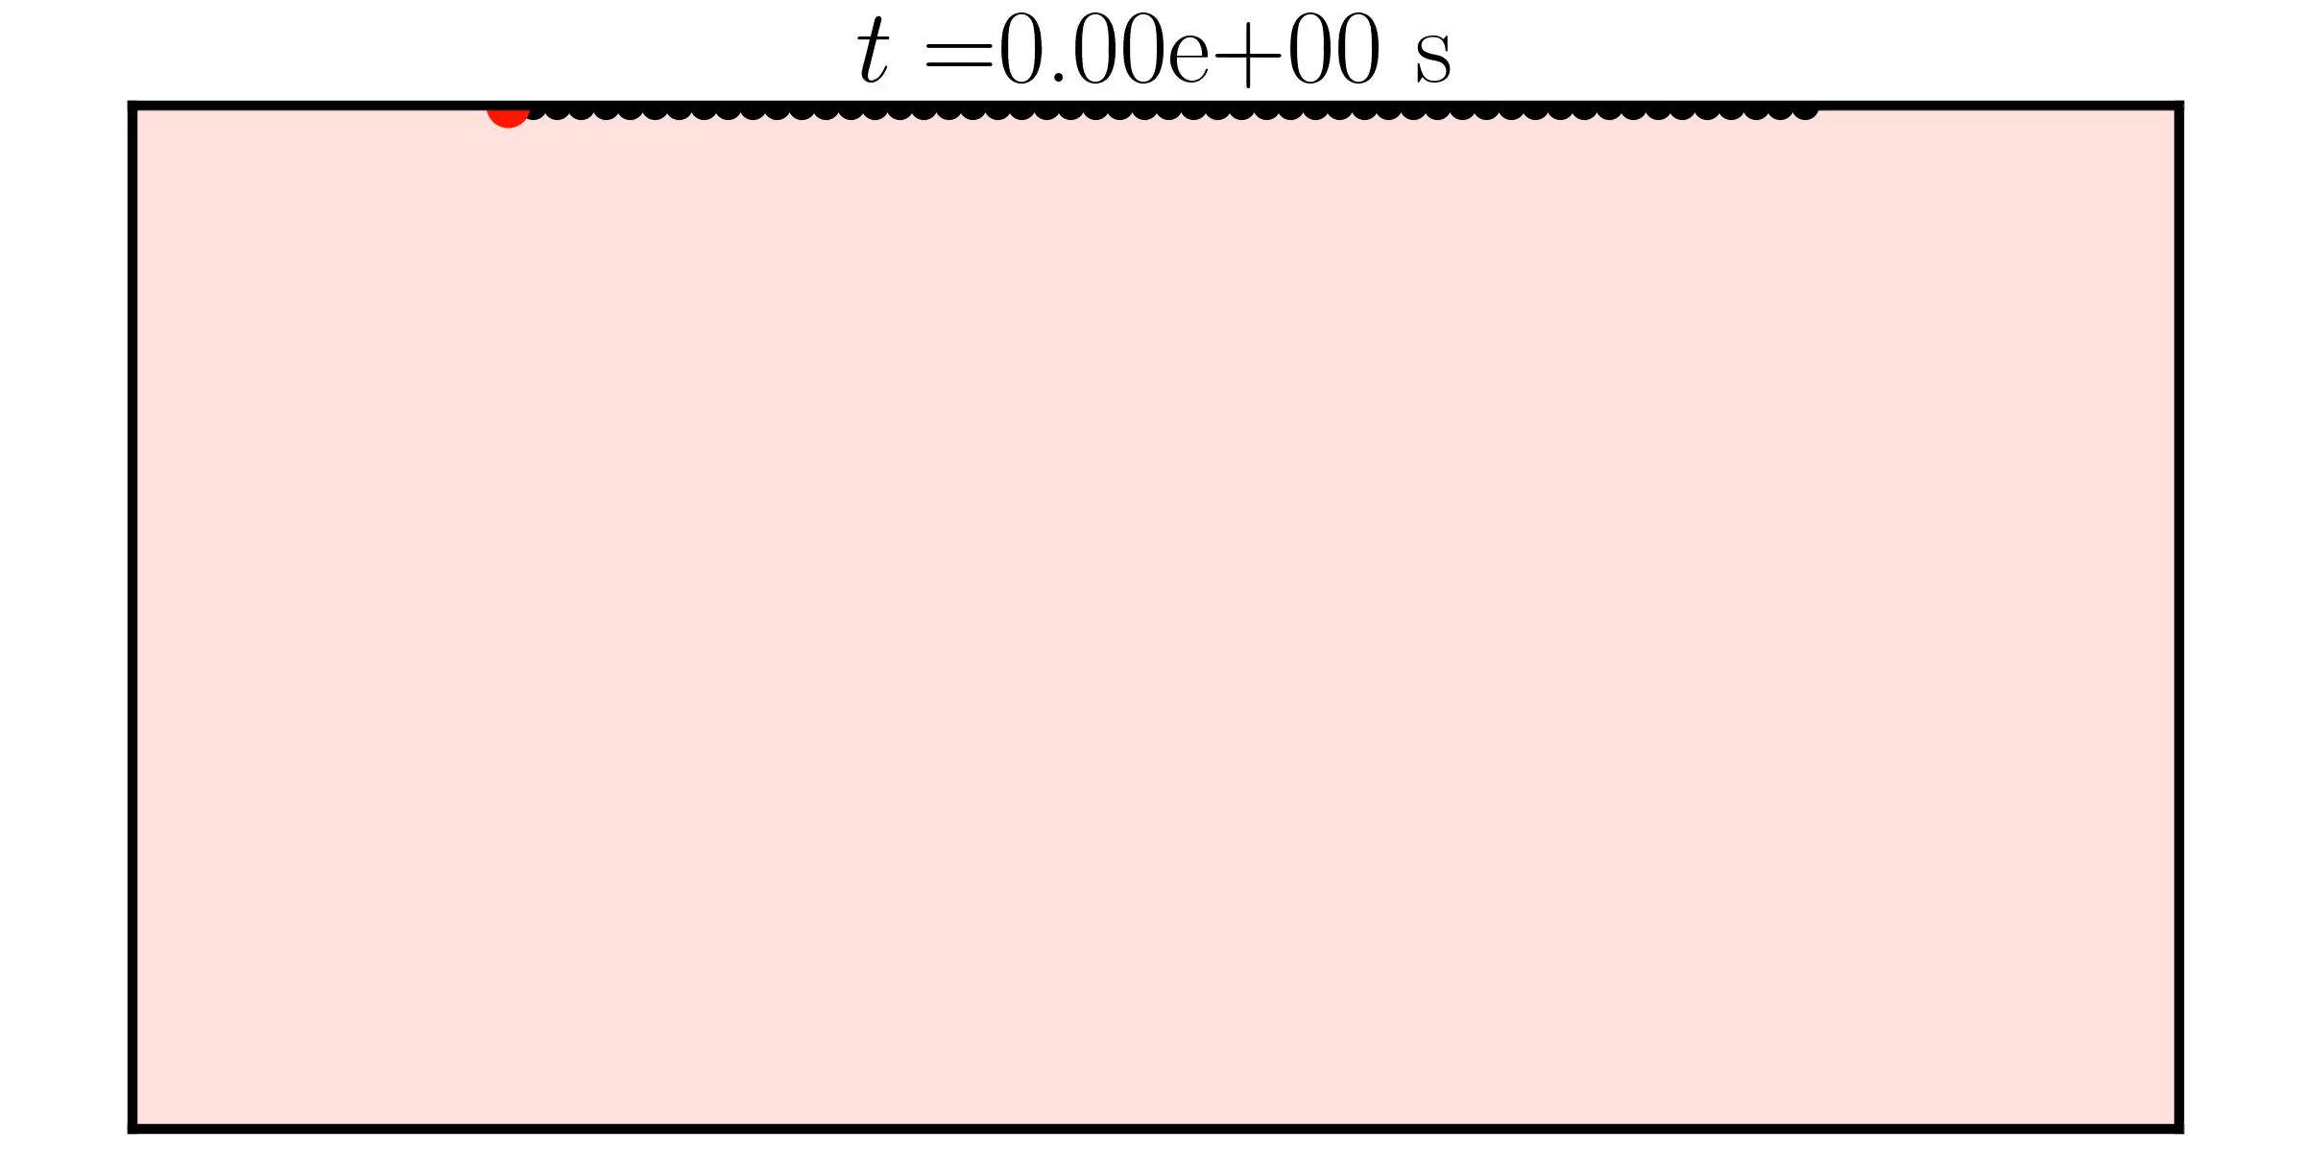
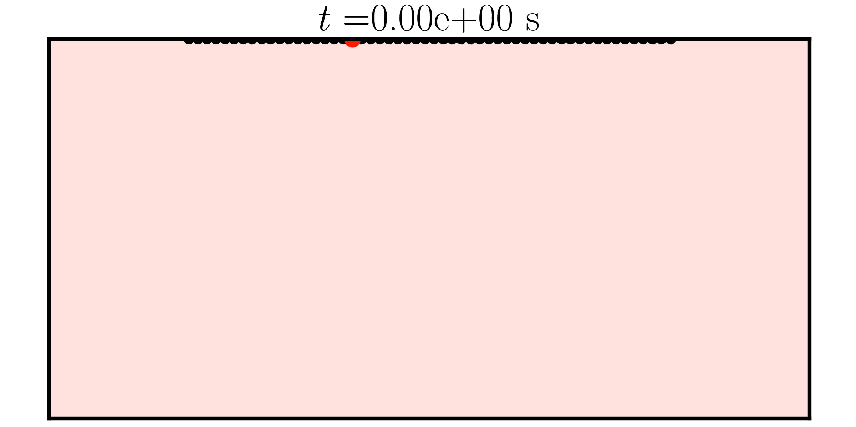
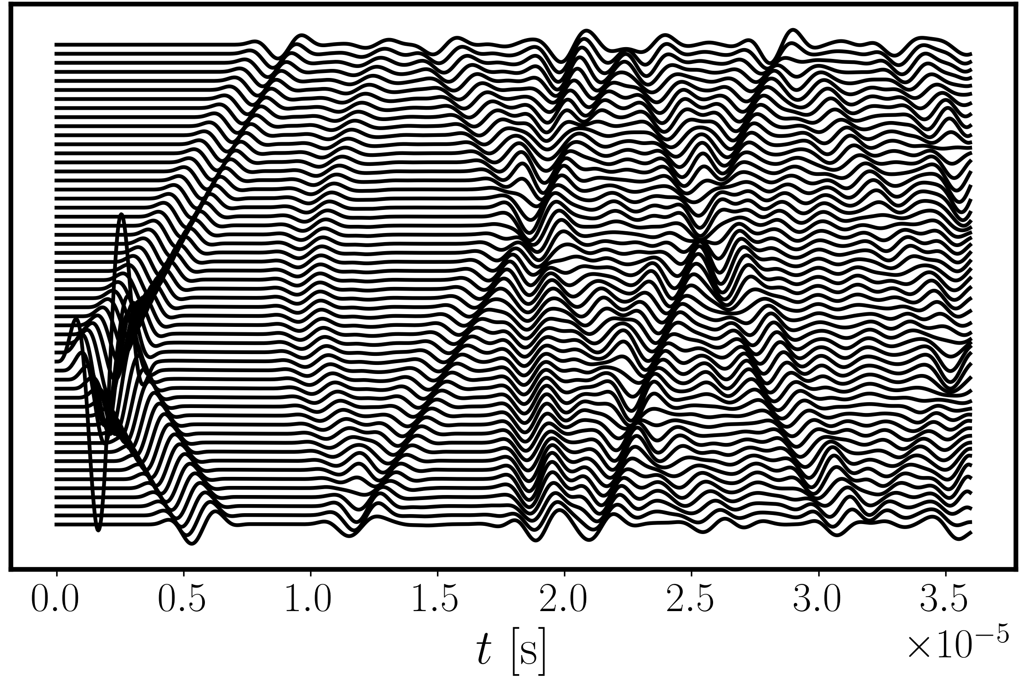
9.2 Ultrasonic Nondestructive Testing
Ultrasonic Identification of flaws uses
Ultrasonic pulses (e.g., Ricker wavelet, or sinusoidal burst)
Measurements of the pulses after traversal through the material
Plate with a hole
Sinusoidal burst
We will rely on a technique called full waveform inversion for the inversion (which relies on the wave equation)

Slide 4
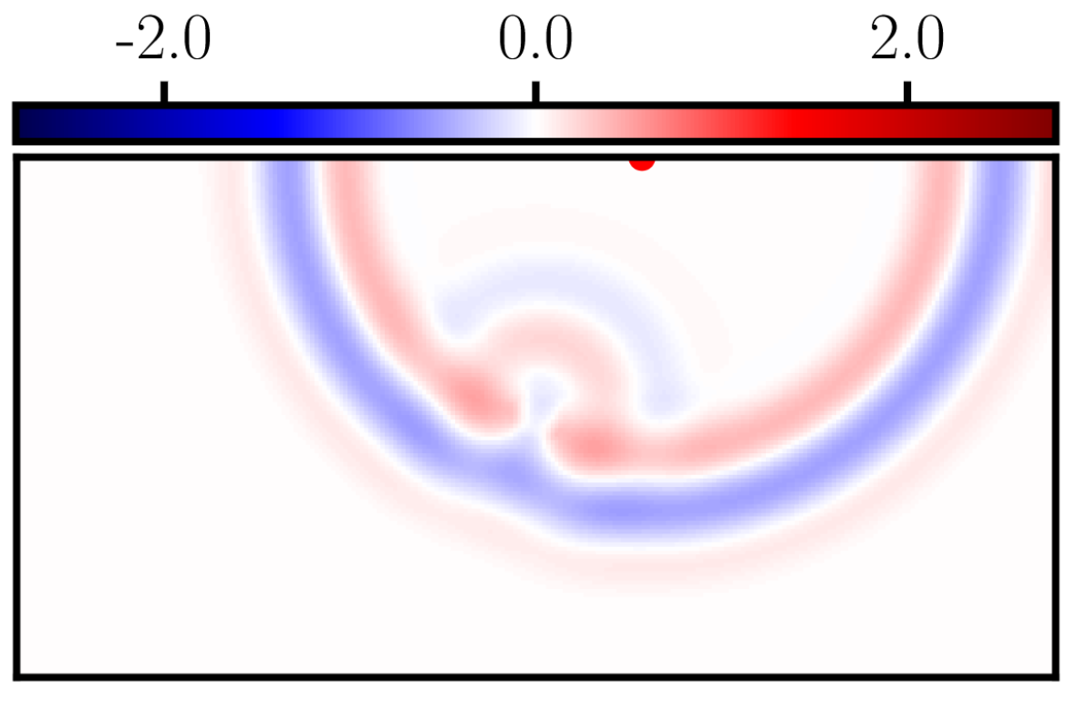
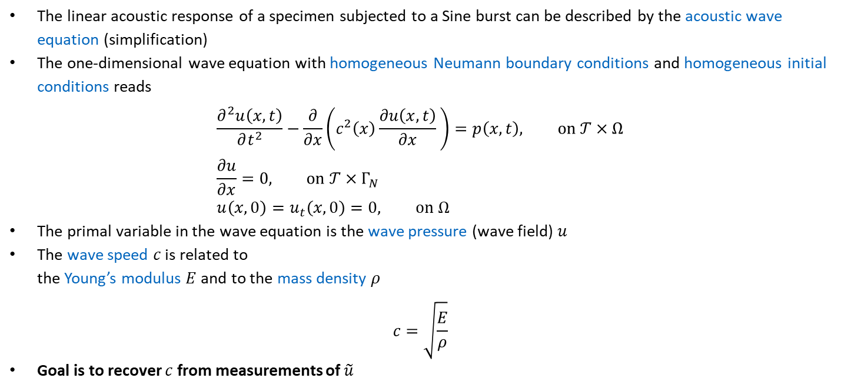
9.2.1 Acoustic Wave Equation
The linear acoustic response of a specimen subjected to a Sine burst can be described by the acoustic wave equation (simplification)
The one-dimensional wave equation with homogeneous Neumann boundary conditions and homogeneous initial conditions reads
$$\frac{∂^{2}u\left(x,t\right)}{∂t^{2}}−\frac{∂}{∂x}\left(c^{2}\left(x\right)\frac{∂u\left(x,t\right)}{∂x} \right)=p\left(x,t\right), on 𝒯×Ω \\ \frac{∂u}{∂x}=0, on 𝒯×Γ_{N} \\ u\left(x, 0\right)=u_{t}\left(x, 0\right)=0, on Ω$$
The primal variable in the wave equation is the wave pressure (wave field) $u$
The wave speed $c$ is related to the Young’s modulus $E$and to the mass density $ρ$
$$c=\sqrt{\frac{E}{ρ}}$$
Goal is to recover $c$ from measurements of $\tilde{u}$
In principle, the elastic wave equation should be considered.

Slide 5
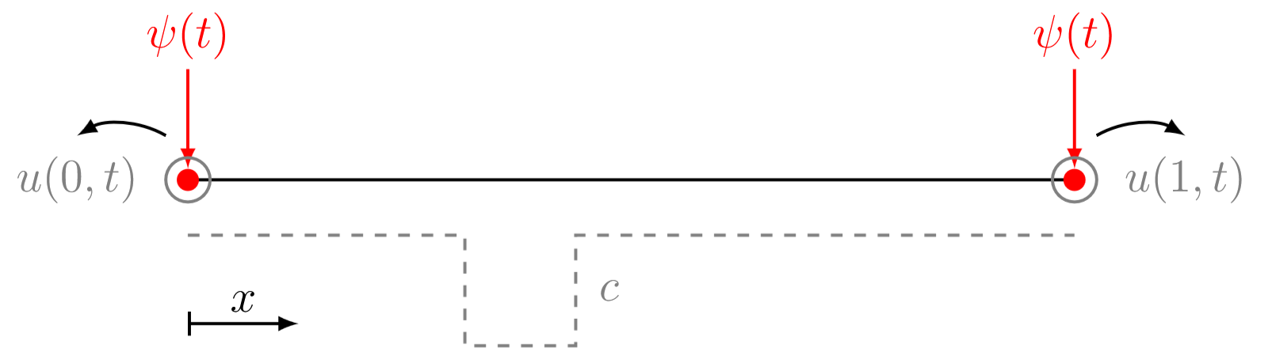
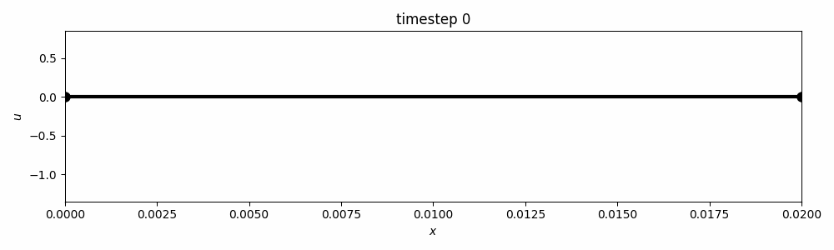
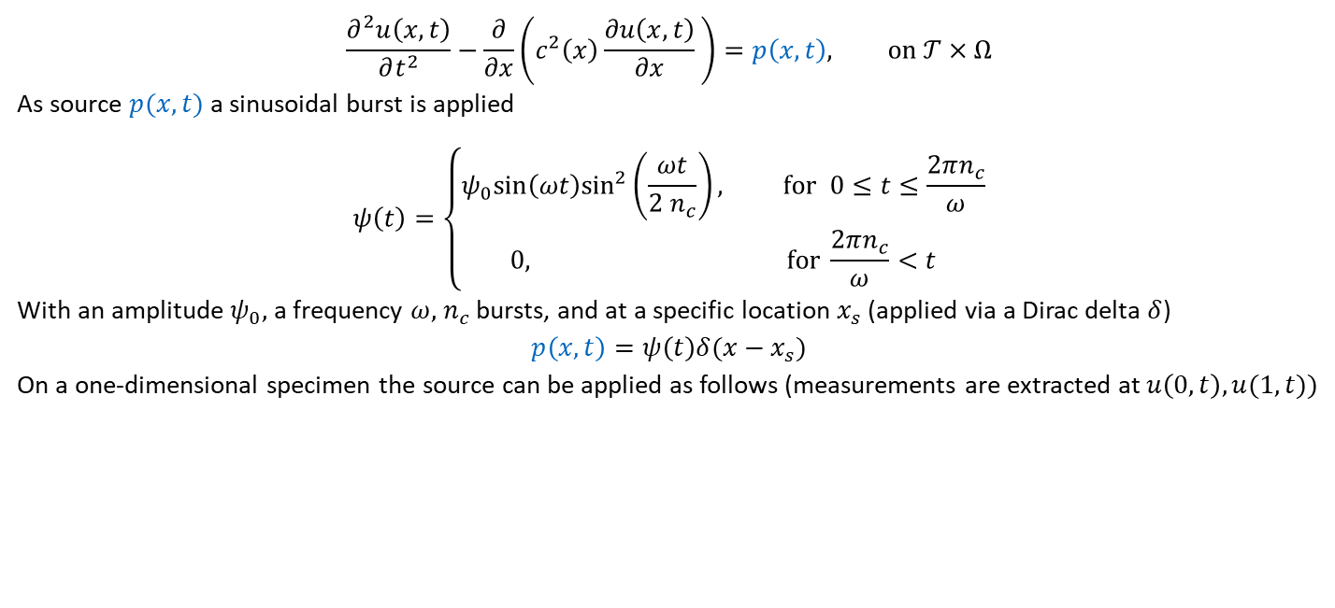
9.2.1 Acoustic Wave Equation
$$\frac{∂^{2}u\left(x,t\right)}{∂t^{2}}−\frac{∂}{∂x}\left(c^{2}\left(x\right)\frac{∂u\left(x,t\right)}{∂x} \right)=p\left(x,t\right), on 𝒯×Ω$$
As source $p(x,t)$ a sinusoidal burst is applied
$$ψ\left(t\right)=\left\{\begin{aligned}ψ_{0}sin\left(ωt\right)\sin^{2}\left(\frac{ωt}{2 n_{c}}\right), for 0≤t≤\frac{2πn_{c}}{ω} \\ 0, for \frac{2πn_{c}}{ω}<t\end{aligned}\right.$$
With an amplitude $ψ_{0}$, a frequency $ω$, $n_{c}$ bursts, and at a specific location $x_{s}$ (applied via a Dirac delta $δ$) $$p\left(x,t\right)=ψ\left(t\right)δ(x−x_{s})$$
On a one-dimensional specimen the source can be applied as follows (measurements are extracted at $u\left(0,t\right), u(1,t)$)

Slide 6
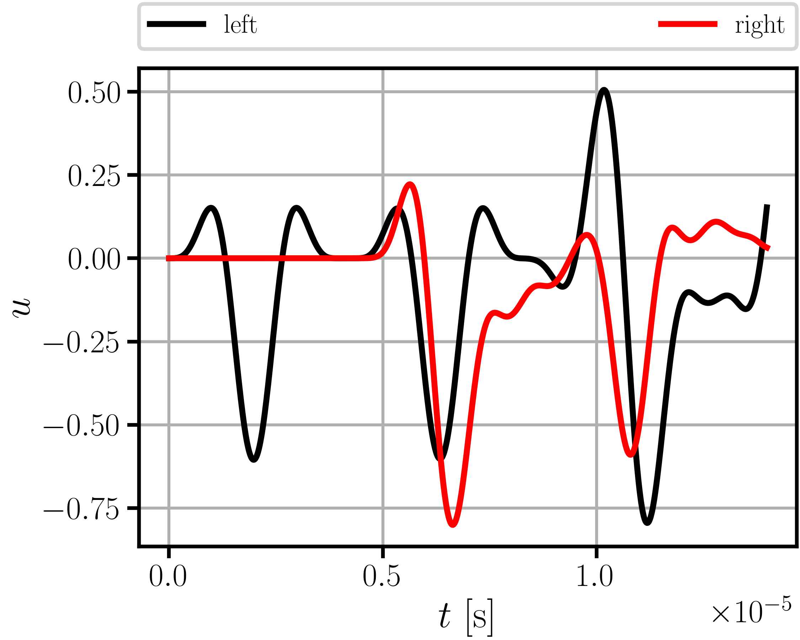
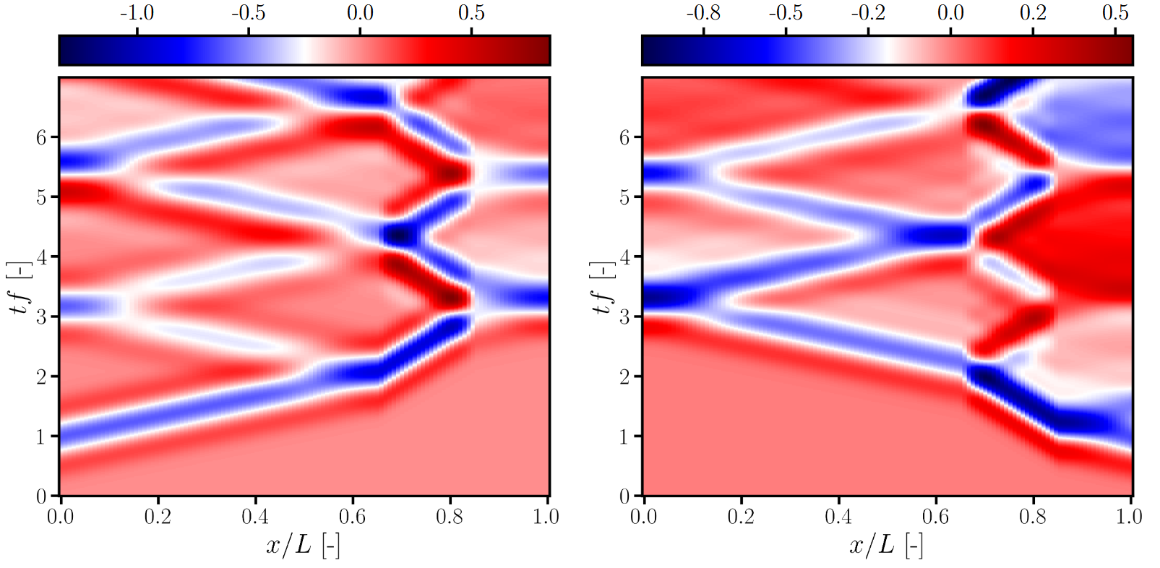
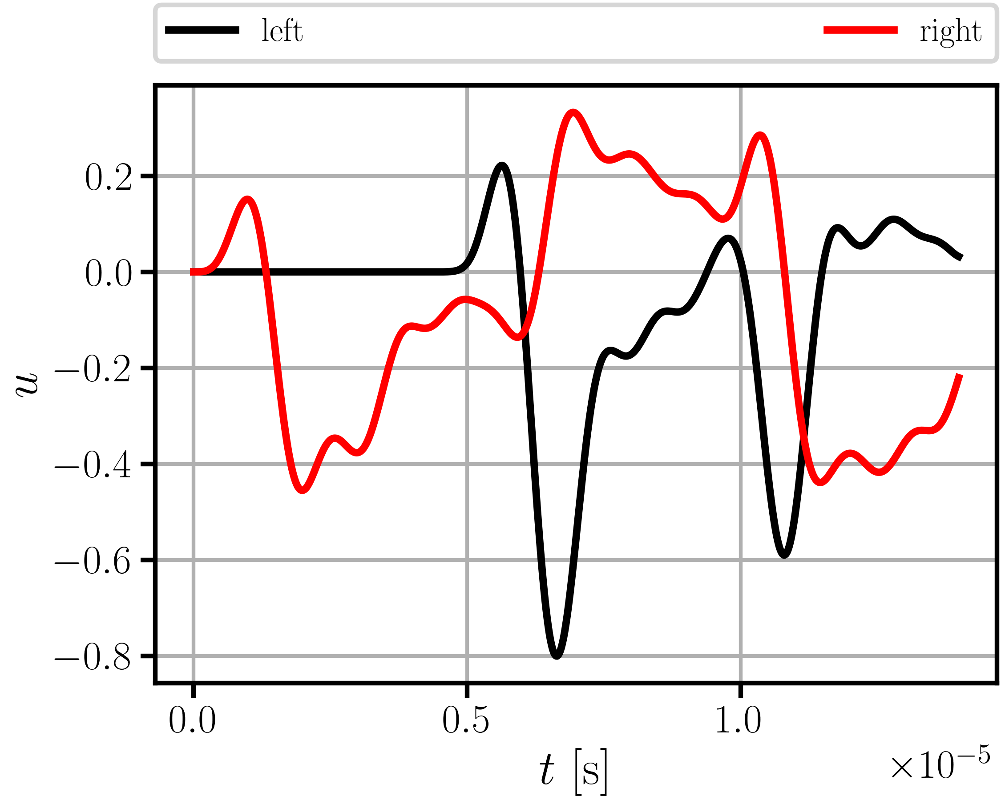
9.2.1 Acoustic Wave Equation – Results
Sinusoidal burst applied on left boundary
The wave field can be computed with the finite difference method (see 9.2.2)
Sinusoidal burst applied on right boundary
Sinusoidal burst applied on left boundary
Sinusoidal burst applied on right boundary
How to identify $c$ from the 4 measurement signals of $u\left(0,t\right), u(1,t)$? (not the full field!) Physics-informed neural networks, iterative forward solver, or data-driven solver?

Slide 7
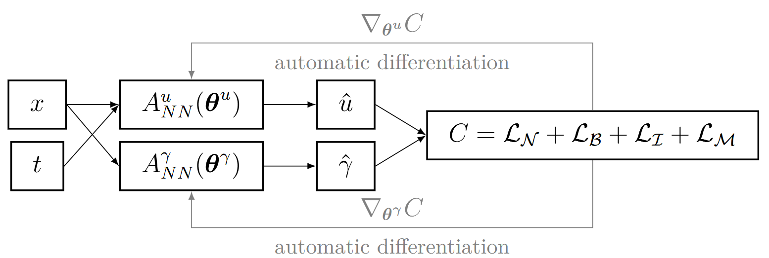
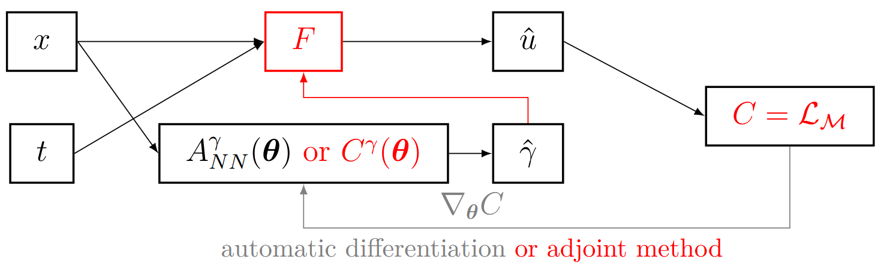
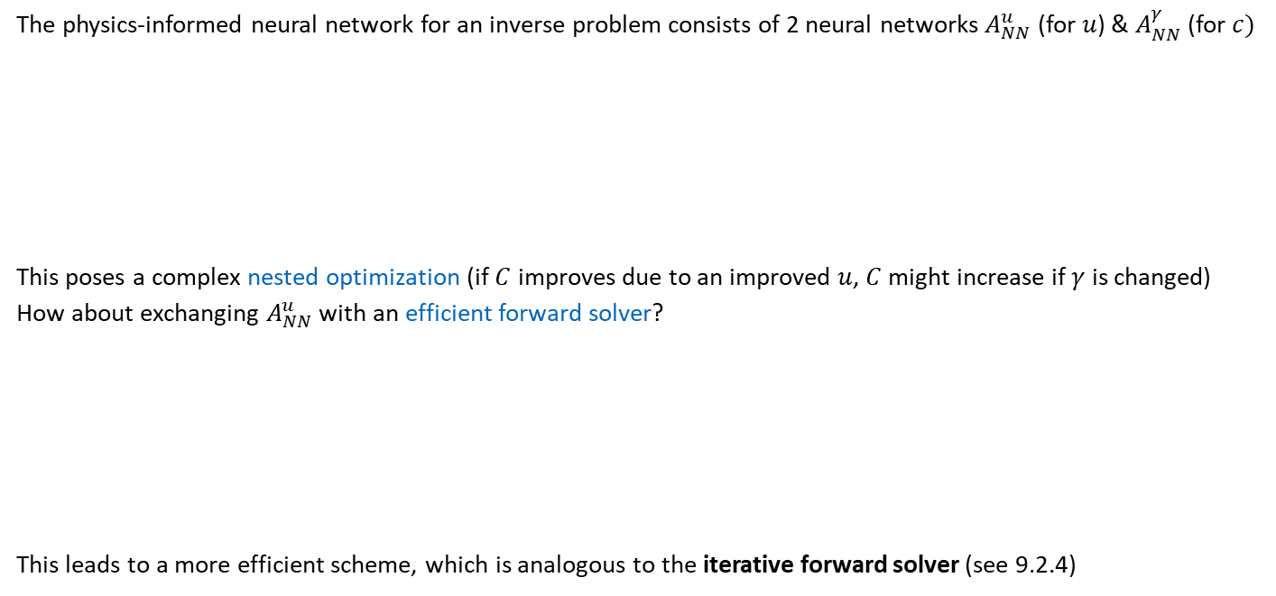
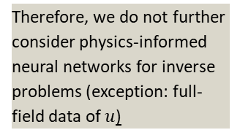
9.2.3 Physics-Informed Neural Networks
On the use of neural networks for full waveform inversion, Herrmann et al. 2023
The physics-informed neural network for an inverse problem consists of 2 neural networks $A_{NN}^{u}$ (for $u$) & $A_{NN}^{γ}$ (for $c)$
This poses a complex nested optimization (if $C$ improves due to an improved $u$, $C$ might increase if $γ$ is changed)
How about exchanging $A_{NN}^{u}$ with an efficient forward solver?
This leads to a more efficient scheme, which is analogous to the iterative forward solver (see 9.2.4)
Potentially many local optima
Therefore, we do not further consider physics-informed neural networks for inverse problems (exception: full-field data of $u$)

Slide 8
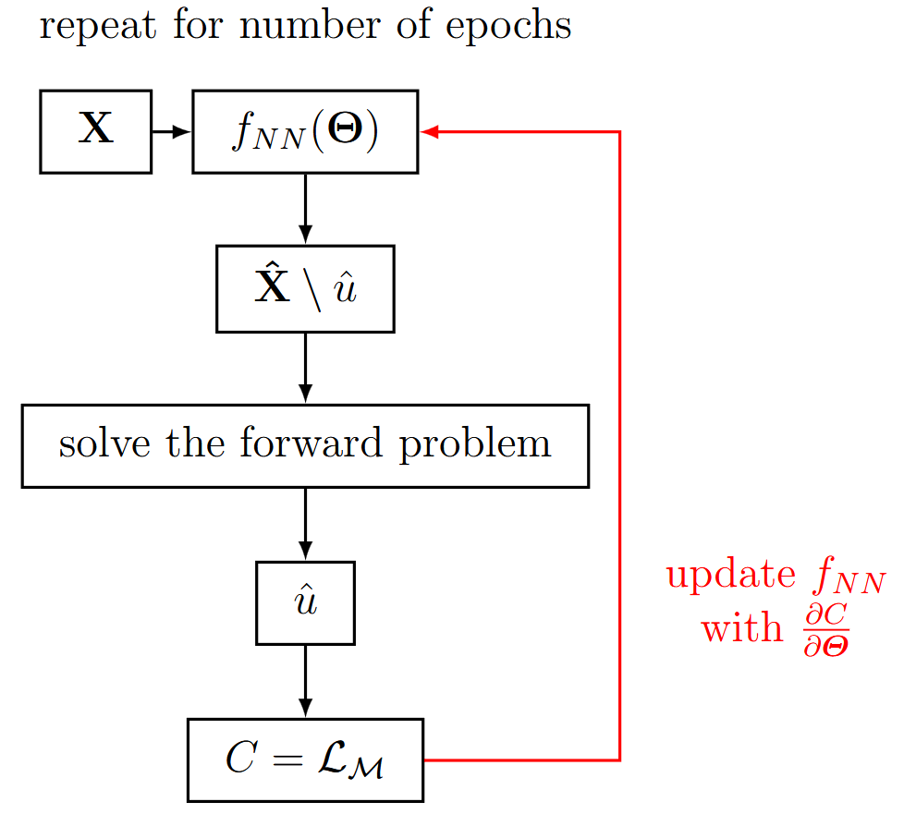
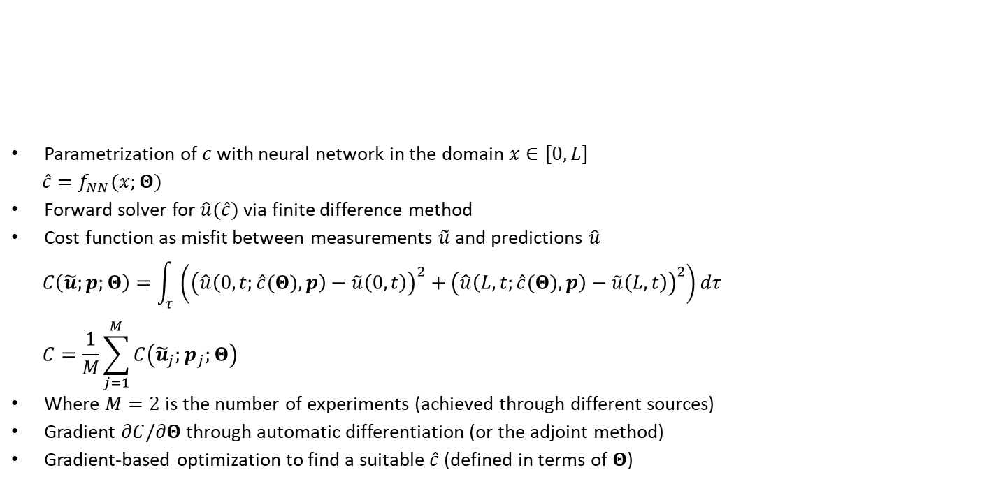
9.2.4 Iterative Forward Solver (with Neural Network)
Parametrization of $c$ with neural network in the domain $x∈[0,L]$
$$\hat{c}=f_{NN}(x;Θ)$$
Forward solver for $\hat{u}(\hat{c})$ via finite difference method
Cost function as misfit between measurements $\tilde{u}$ and predictions $\hat{u}$
$$C\left(\tilde{u};p;Θ\right)=\int_{τ}^{ }{\left({\left(\hat{u}\left(0,t;\hat{c}(Θ),p\right)−\tilde{u}\left(0,t\right)\right)}^{2}+{\left(\hat{u}\left(L,t;\hat{c}(Θ),p\right)−\tilde{u}\left(L,t\right)\right)}^{2}\right)}dτ \\ C=\frac{1}{M}\sum_{j=1}^{M}{C\left({\tilde{u}}_{j};p_{j};Θ\right)}$$
Where $M=2$ is the number of experiments (achieved through different sources)
Gradient $∂C/∂Θ$ through automatic differentiation (or the adjoint method)
Gradient-based optimization to find a suitable $\hat{c}$ (defined in terms of $Θ$)

Slide 9
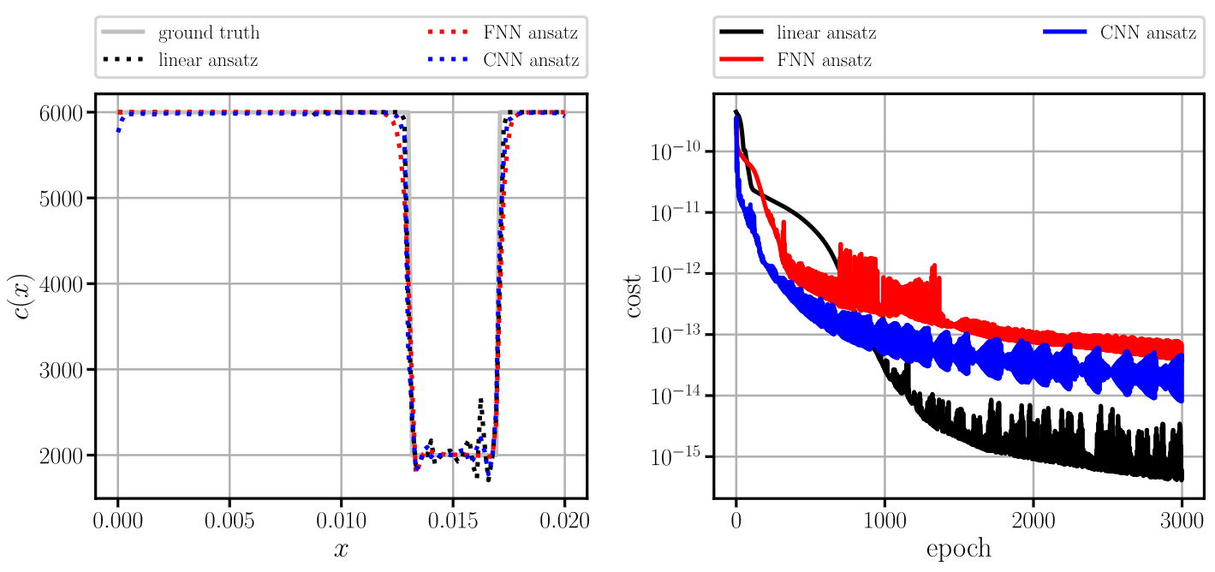
9.2.4 Iterative Forward Solver (with Neural Network)
Notes:
Linear Ansatz converges to the lowest cost fuction value, but shows wiggles (why is that?) -> the cost function does not evaluate against the ground truth of the full field measurement
The Convolutional Network and Fully Connected NN show similar results. -> it does not seem to matter which network is employed. But CNN has less parameters…possibly its cheaper?
Sharp edges are observed with the Neural Networks… with slight overshoots….

Slide 10
Exercises
E.33 Iterative Forward Solver (C)
Apply an iterative forward solver to a one-dimensional full waveform inversion example. Tune the hyperparameters and compare the three different ansatz functions.

Slide 11
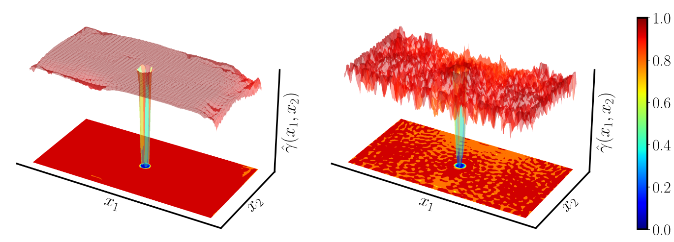
9.2.4 Iterative Forward Solver with Neural Network
On the use of neural networks for full waveform inversion, Herrmann et al. 2023
Two-dimensional example: plate with a hole:
Neural network has a regularizing effect, i.e., produces a smoother material field
(Convolutional) neural network ansatz
Linear ansatz

Slide 12
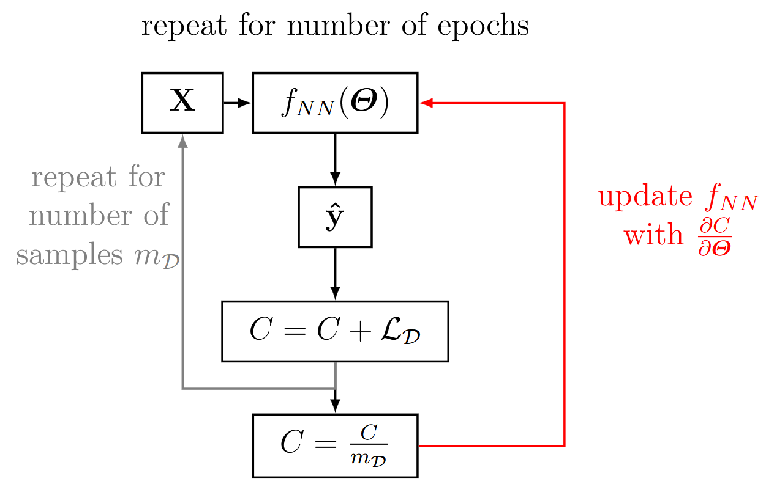
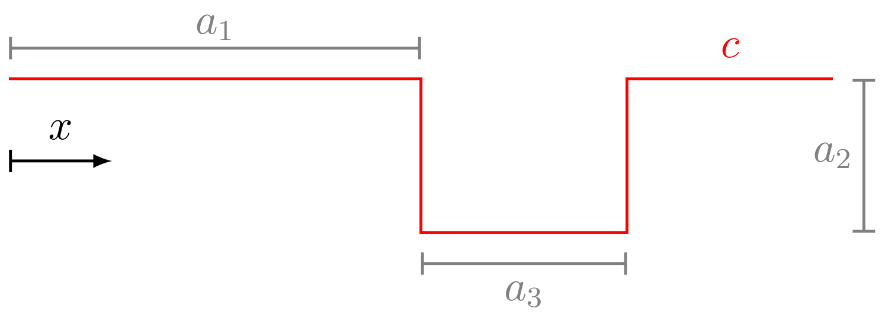
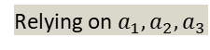
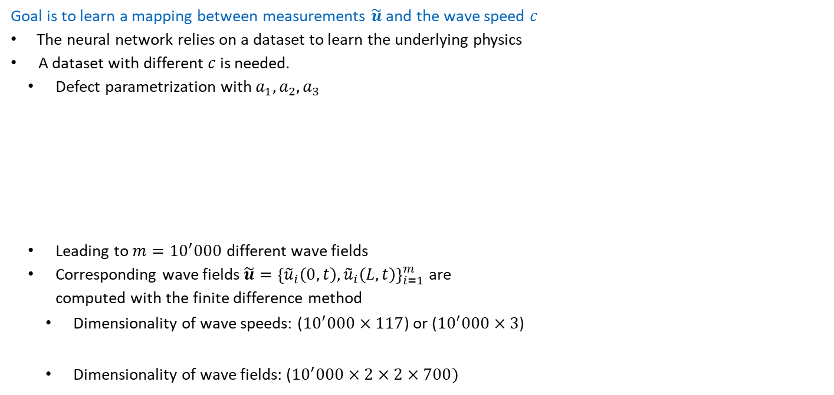
9.2.5 Data-Driven Solver
Goal is to learn a mapping between measurements $\tilde{u}$ and the wave speed $c$
The neural network relies on a dataset to learn the underlying physics
A dataset with different $c$ is needed.
Defect parametrization with $a_{1},a_{2},a_{3}$
Leading to $m={10}^{′}000$ different wave fields
Corresponding wave fields $\tilde{u}={\left\{{\tilde{u}}_{i}\left(0,t\right), {\tilde{u}}_{i}\left(L,t\right)\right\}}_{i=1}^{m}$ are computed with the finite difference method
Dimensionality of wave speeds: (${10}^{′}000×117$) or (${10}^{′}000×3$)
Dimensionality of wave fields: (${10}^{′}000×2×2×700)$
Due to spatial discretization (117 points) & number of time steps (700)
Relying on $a_{1},a_{2},a_{3}$

Slide 13
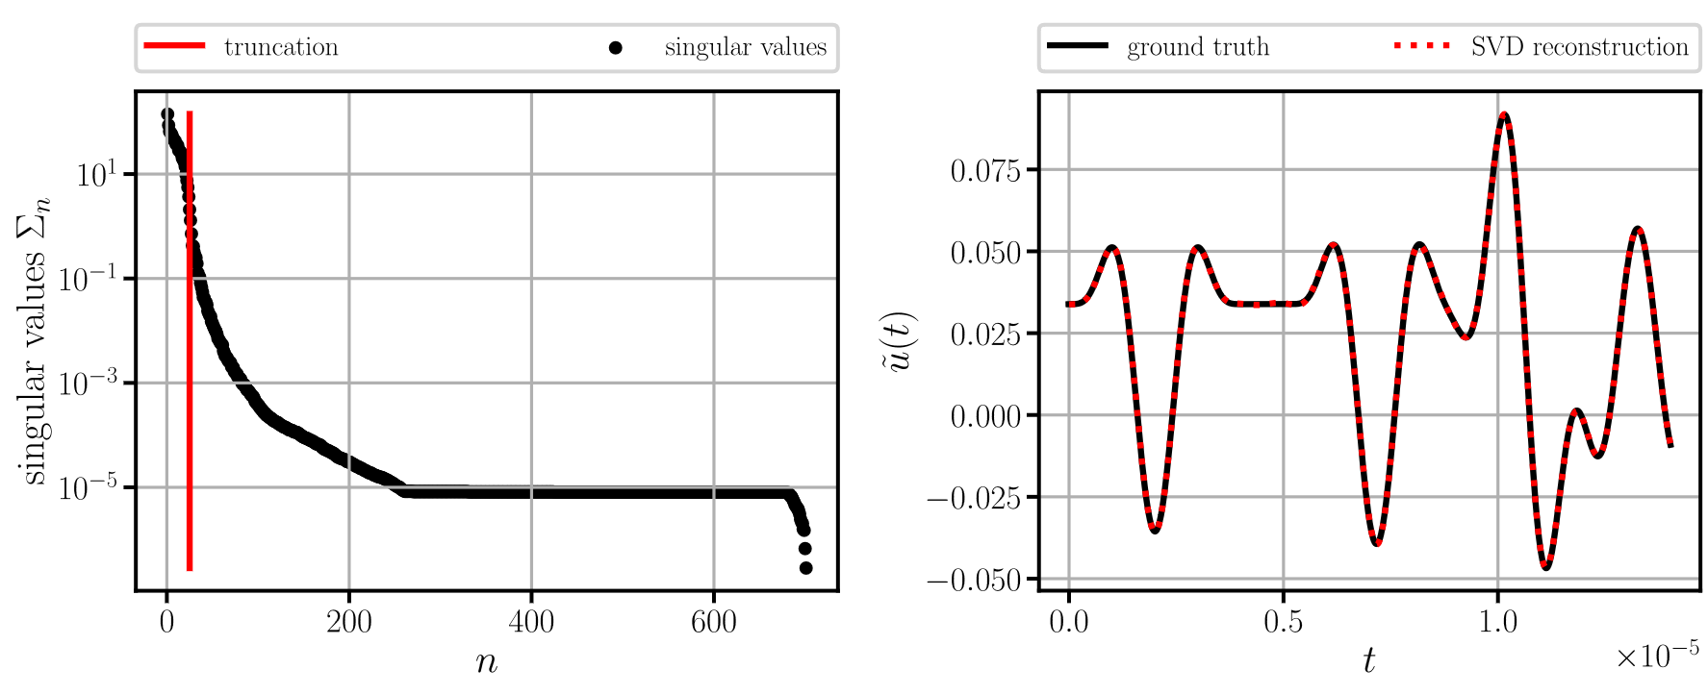
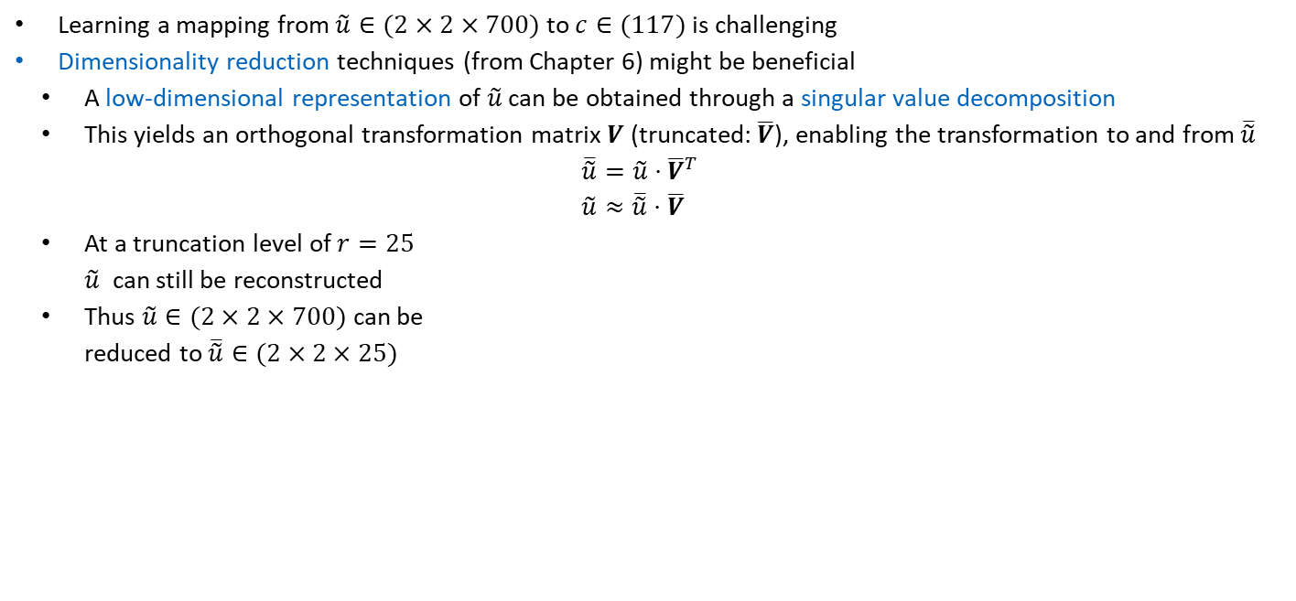
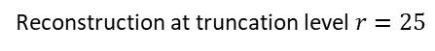
9.2.5 Data-Driven Solver
Learning a mapping from $\tilde{u}∈(2×2×700)$ to $c∈(117)$ is challenging
Dimensionality reduction techniques (from Chapter 6) might be beneficial
A low-dimensional representation of $\tilde{u}$ can be obtained through a singular value decomposition
This yields an orthogonal transformation matrix $V$ (truncated: $\overline{V}$), enabling the transformation to and from $\overline{\tilde{u}}$
$$\overline{\tilde{u}}=\tilde{u}⋅{\overline{V}}^{T} \\ \tilde{u}≈\overline{\tilde{u}}⋅\overline{V}$$
At a truncation level of $r=25$ $\tilde{u}$ can still be reconstructed
Thus $\tilde{u}∈(2×2×700)$ can be reduced to $\overline{\tilde{u}}∈(2×2×25)$
Singular values
Reconstruction at truncation level $r=25$
Notes:
POD 700 Zeitschritte am Rand x 10.000 Samples (* 2 * 2 )
Reduzierte V Matrix 25*700 und u reduziert hat 25 Koeffizienten

Slide 14
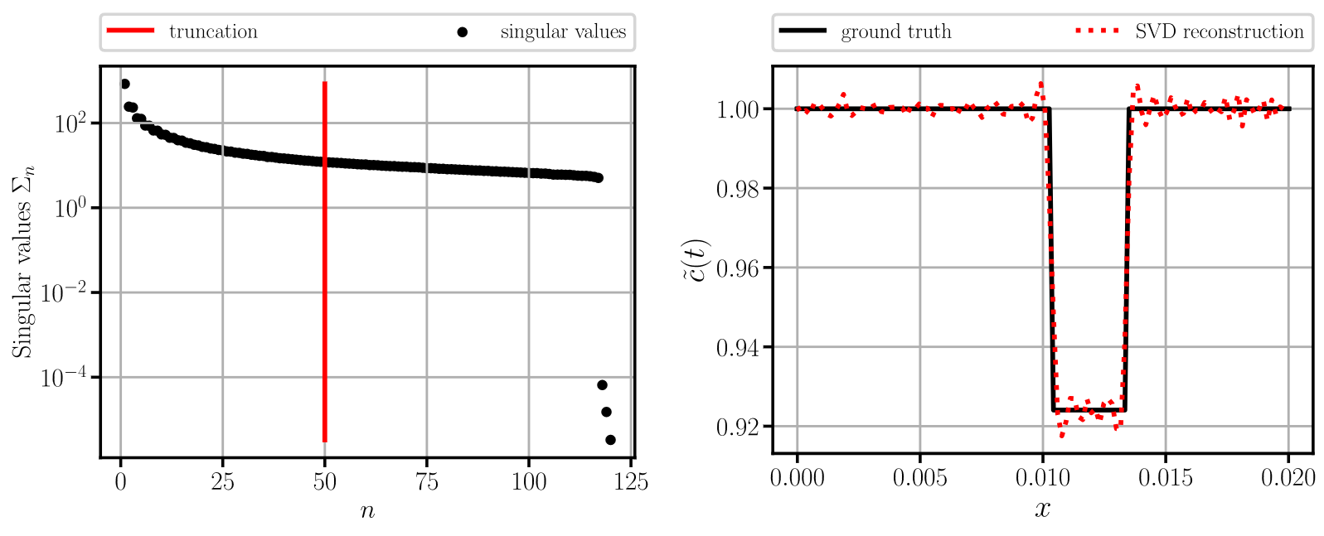
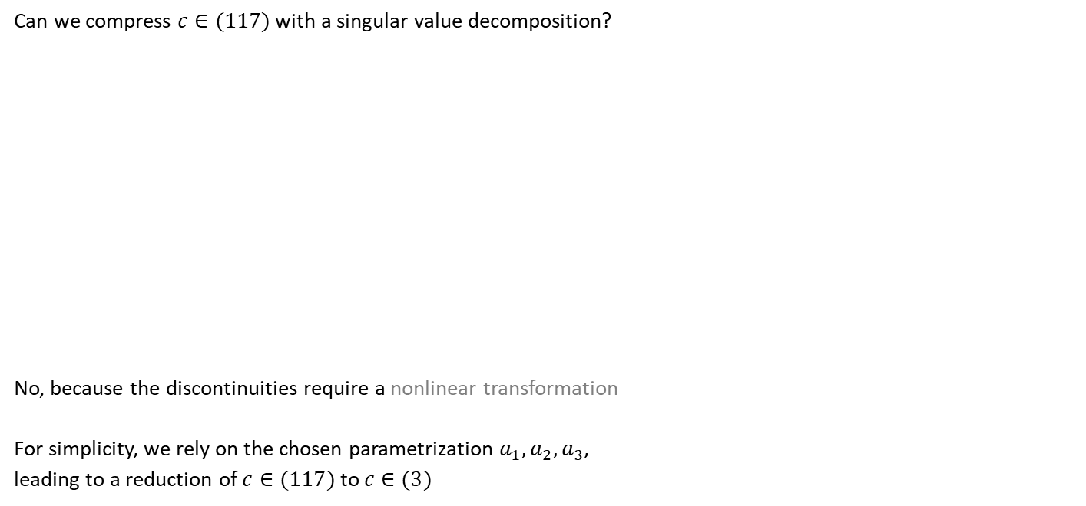
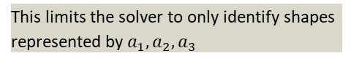
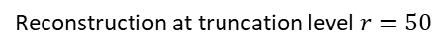
9.2.5 Data-Driven Solver
Can we compress $c∈(117)$ with a singular value decomposition?
No, because the discontinuities require a nonlinear transformation
For simplicity, we rely on the chosen parametrization $a_{1},a_{2},a_{3}$, leading to a reduction of $c∈(117)$ to $c∈(3)$
Singular values
Reconstruction at truncation level $r=50$
Could be achieved by nonlinear techniques, such as autoencoders (see Chapter 8)
This limits the solver to only identify shapes represented by $a_{1},a_{2},a_{3}$

Slide 15
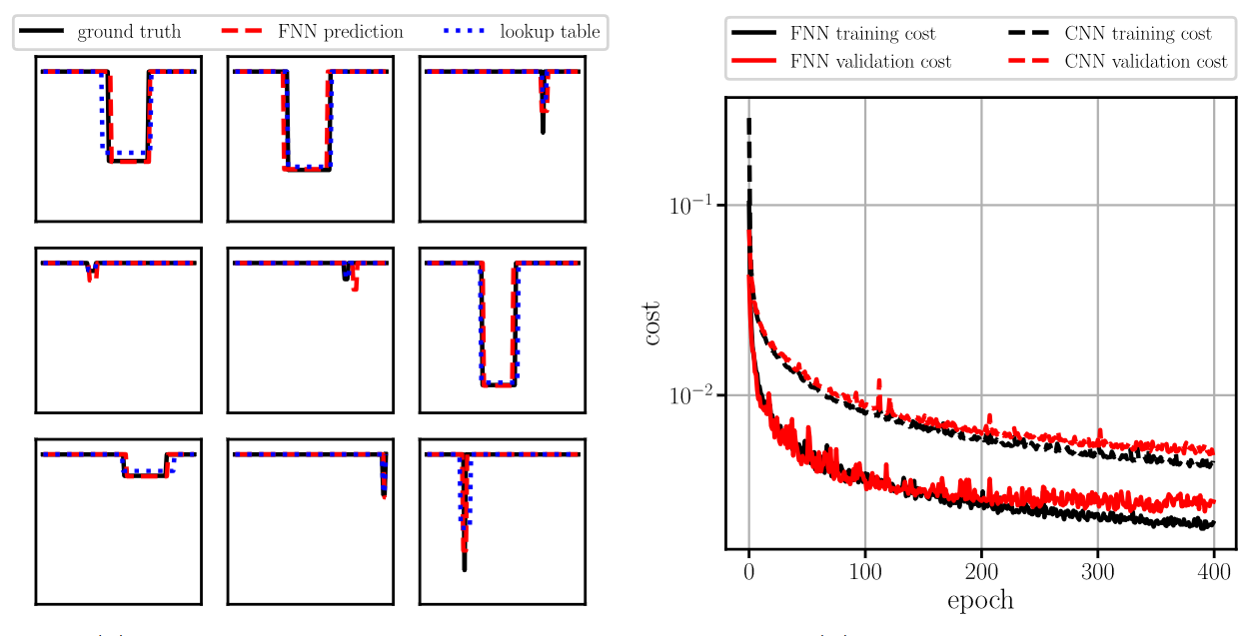
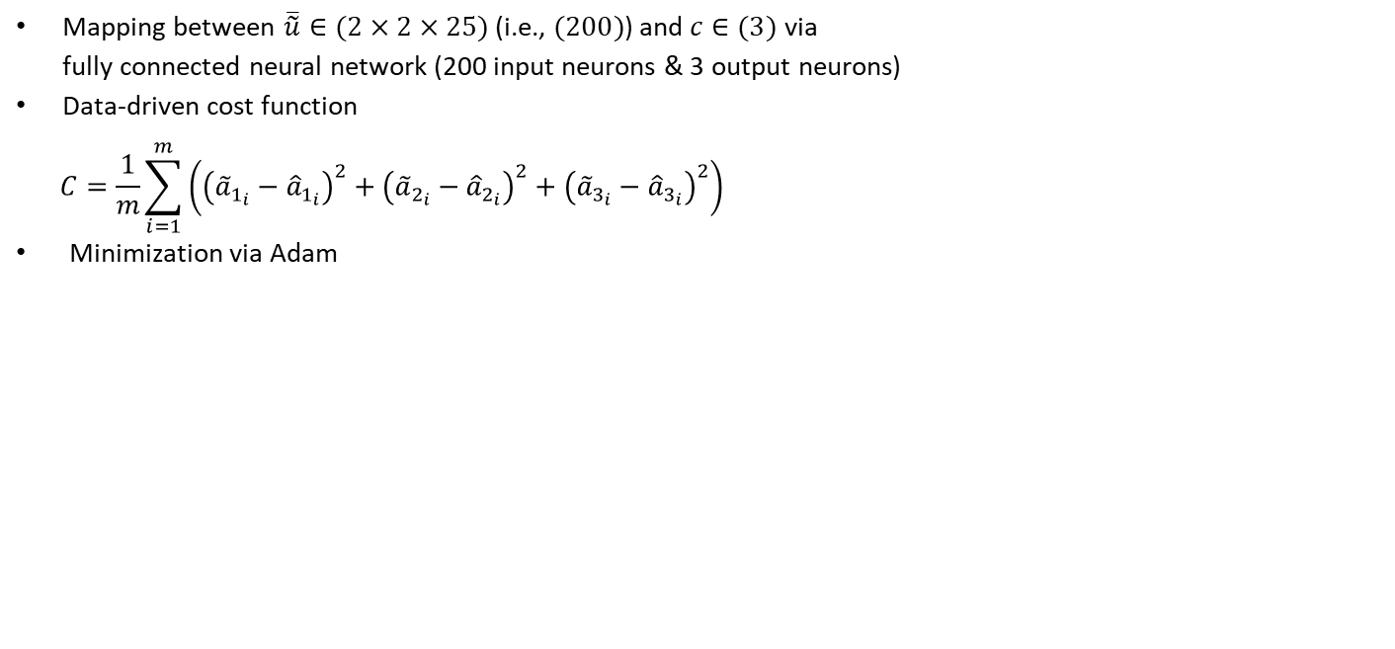
9.2.5 Data-Driven Solver
Mapping between $\overline{\tilde{u}}∈(2×2×25)$ (i.e., $(200)$) and $c∈(3)$ via fully connected neural network (200 input neurons & 3 output neurons)
Data-driven cost function
$$C=\frac{1}{m}\sum_{i=1}^{m}{\left({\left({\tilde{a}}_{1_{i}}−{\hat{a}}_{1_{i}}\right)}^{2}+{\left({\tilde{a}}_{2_{i}}−{\hat{a}}_{2_{i}}\right)}^{2}+{\left({\tilde{a}}_{3_{i}}−{\hat{a}}_{3_{i}}\right)}^{2}\right)}$$
Minimization via Adam

Slide 16
Exercises
E.34 Data-Driven Solver (C)
Train a data-driven solver to learn the mapping between wave field and the spatial wave velocity distribution. Begin with a dataset generation and a linear dimensionality reduction using singular value decomposition.

Slide 17
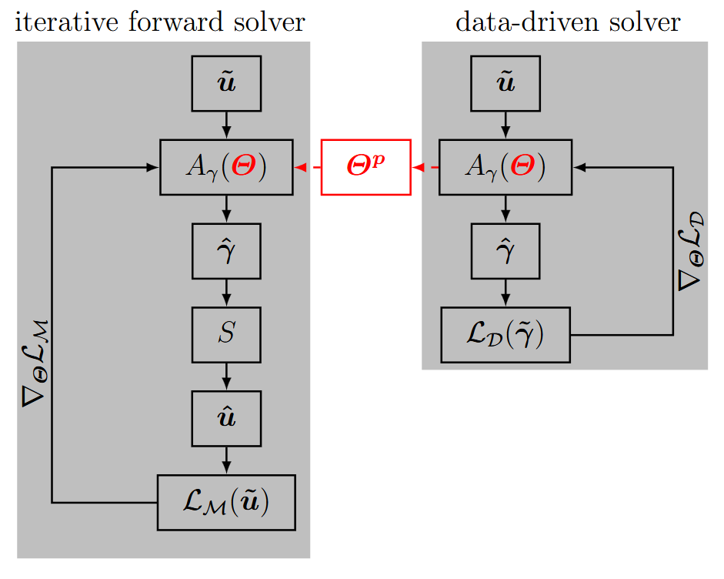
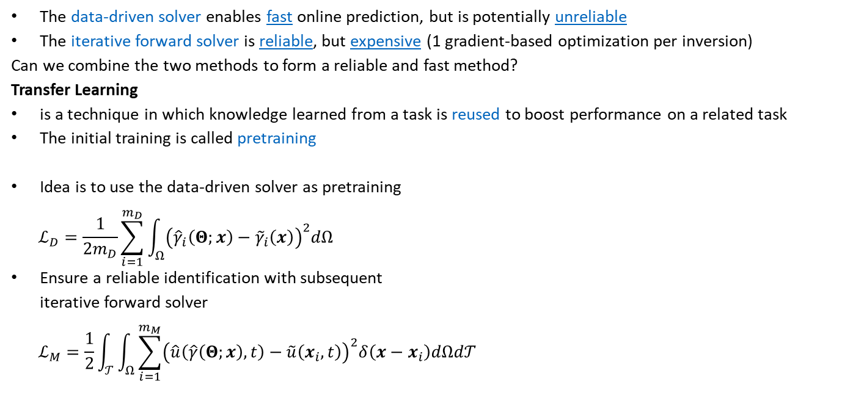
9.2.5.1 Transfer Learning
Accelerating full waveform inversion by transfer learning, Singh et al. 2025
The data-driven solver enables fast online prediction, but is potentially unreliable
The iterative forward solver is reliable, but expensive (1 gradient-based optimization per inversion)
Can we combine the two methods to form a reliable and fast method?
Transfer Learning
is a technique in which knowledge learned from a task is reused to boost performance on a related task
The initial training is called pretraining
Idea is to use the data-driven solver as pretraining
$$ℒ_{D}=\frac{1}{2m_{D}}\sum_{i=1}^{m_{D}}{\int_{Ω}^{ }{{\left({\hat{γ}}_{i}\left(Θ;x\right)−{\tilde{γ}}_{i}\left(x\right)\right)}^{2}dΩ}}$$
Ensure a reliable identification with subsequent iterative forward solver
$$ℒ_{M}=\frac{1}{2}\int_{𝒯}^{ }{\int_{Ω}^{ }{\sum_{i=1}^{m_{M}}{{\left(\hat{u}\left(\hat{γ}\left(Θ;x\right),t\right)−\tilde{u}\left(x_{i},t\right)\right)}^{2}δ\left(x−x_{i}\right)dΩd𝒯}}}$$

Slide 18
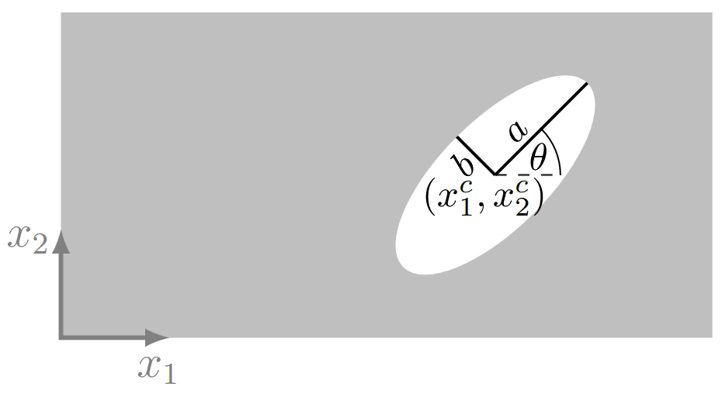
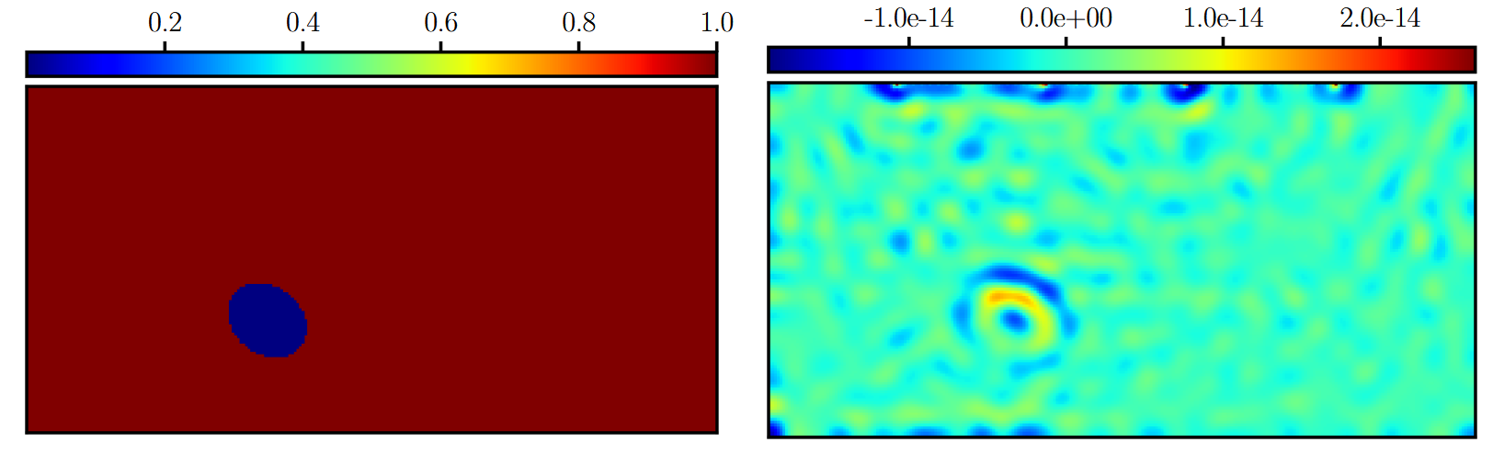
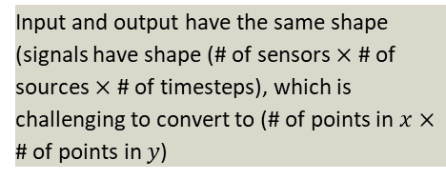
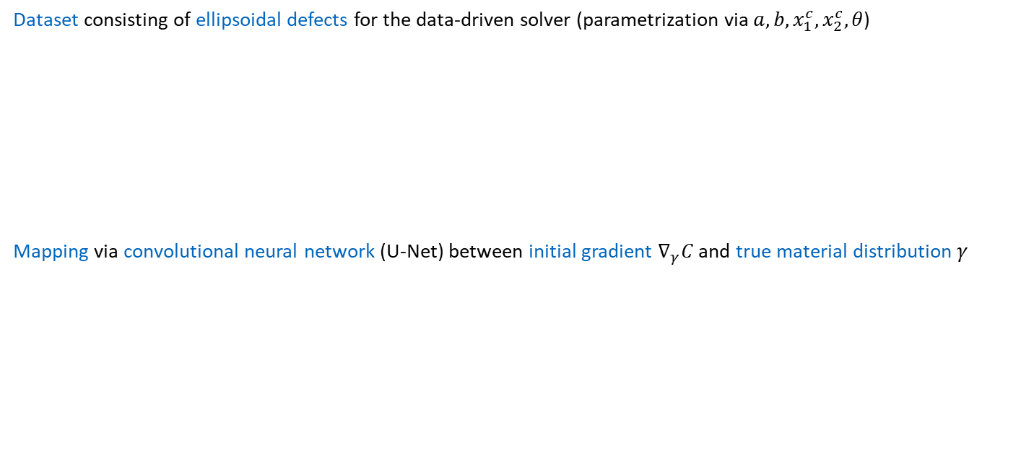
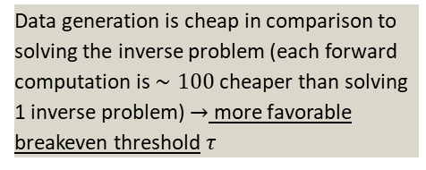
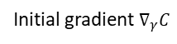
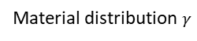
9.2.5.1 Transfer Learning
Dataset consisting of ellipsoidal defects for the data-driven solver (parametrization via $a, b, x_{1}^{c},x_{2}^{c}, θ$)
Mapping via convolutional neural network (U-Net) between initial gradient $∇_{γ}C$ and true material distribution $γ$
Data generation is cheap in comparison to solving the inverse problem (each forward computation is $∼100$ cheaper than solving 1 inverse problem) $→$ more favorable breakeven threshold $τ$
Input and output have the same shape (signals have shape (# of sensors $×$ # of sources $×$ # of timesteps), which is challenging to convert to (# of points in $x$ $×$ # of points in $y$)
Material distribution $γ$
Initial gradient $∇_{γ}C$

Slide 19
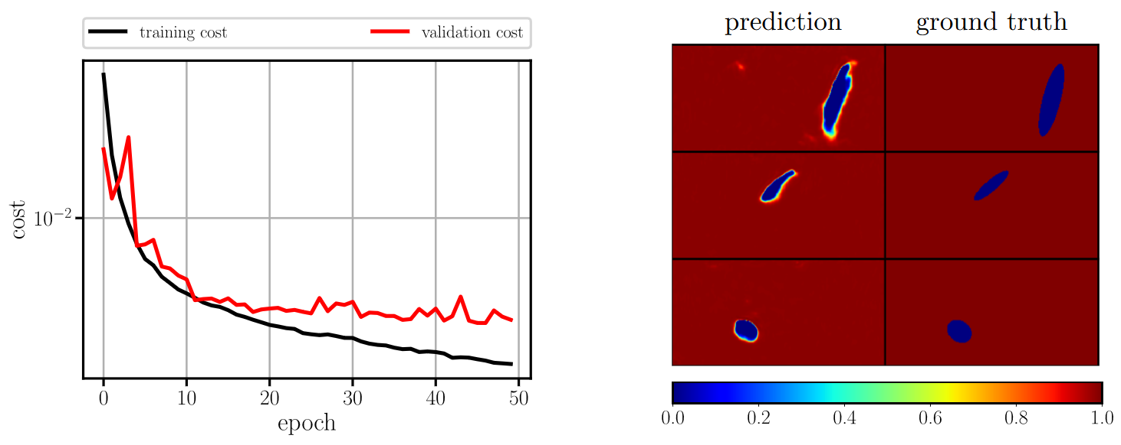
9.2.5.1 Transfer Learning
Accelerating full waveform inversion by transfer learning, Singh et al. 2025
$\sim 100$ samples are sufficient to produce similar results
Predictions of the data-driven solver after training with 1‘800 samples

Slide 20
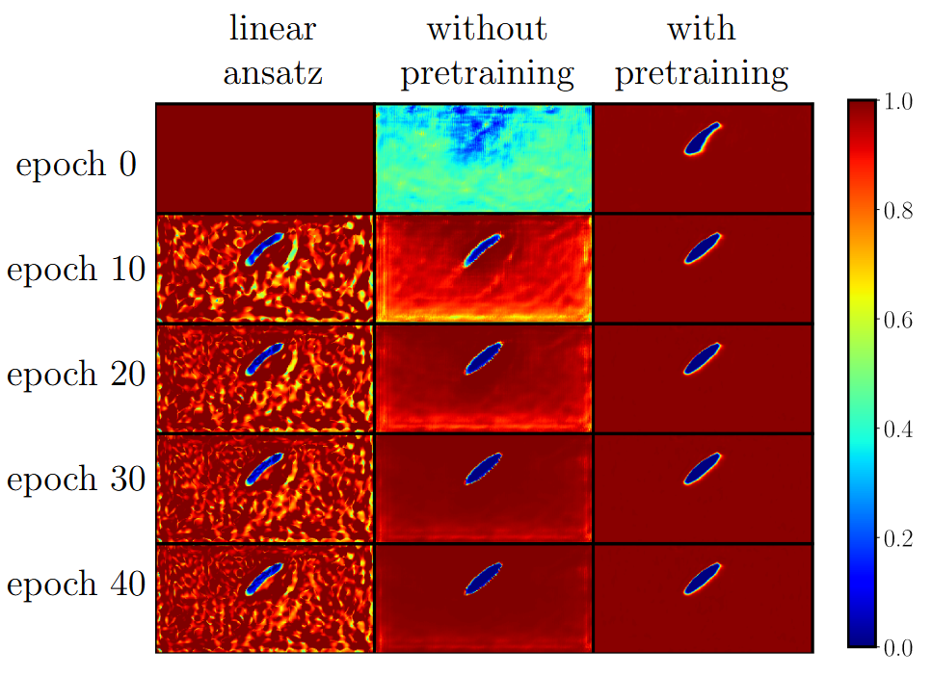
9.2.5.1 Transfer Learning
Acceleration through transfer learning

Slide 21
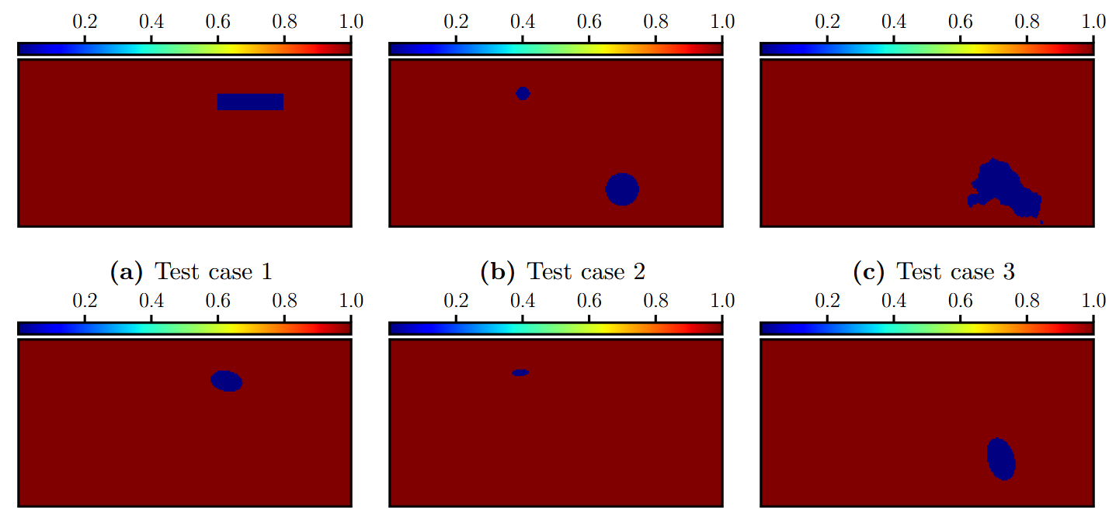
9.2.5.1 Transfer Learning
But what about material outside of the training dataset?
Test cases
Closest material distribution in training dataset

Slide 22
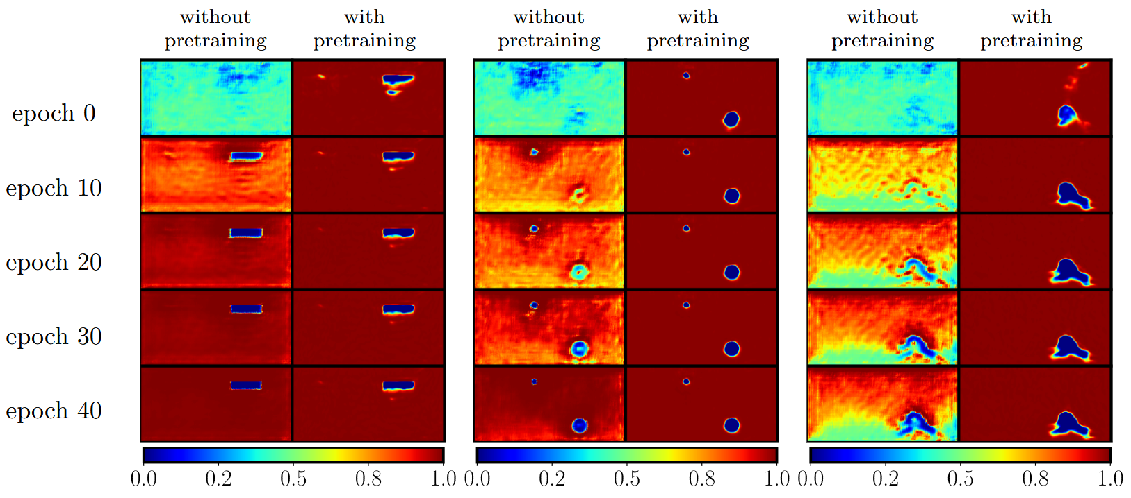
9.2.5.1 Transfer Learning
Acceleration through transfer learning persists

Slide 23
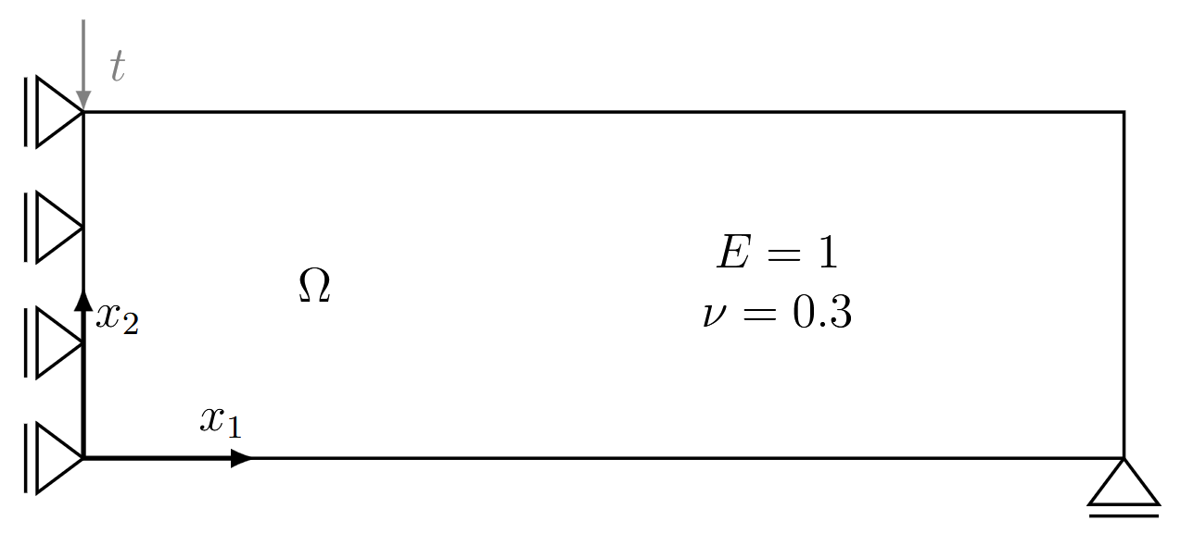


9.3 Topology Optimization
Topology Optimization: Theory, Methods, and Applications, Bendsøe et al. 2004
Topology optimization is a task from computational mechanics that can be framed as minimization problem to
optimize material layout/distribution
based on an objective $ℒ_{O}$ (e.g., stiffness maximization)
under constraints (e.g., material volume, boundary conditions, material properties…)
Typically (most efficiently) achieved through gradient-based optimization
Problem formulation (MBB beam)
Optimized binary material distribution

Slide 24




9.3 Topology Optimization
On the use of artificial neural networks in topology optimisation, Woldseth et al. 2022
Unviable to learn forward and inverse operator in a nested optimization
How to integrate neural networks into topology optimization?
Physics-informed neural networks $→$ unsuitable for inverse problems without full-domain knowledge
Data-driven solvers $→$ minor errors lead to major structural discrepancies (& too expensive data generation)
Compliance $c=F^{T}u$
Difference in MSE: $∼2.5⋅{10}^{−3}$
Transfer learning infeasible because in topology optimization:
a full inversion must be performed for each data pair to be learnt $→$ lack of good pretrained models
Generative approaches do exist, (not treated here, see Chapter 8)
What about a neural network ansatz in an iterative forward solver?
$$c=∼351$$
$$c=∼4^{′}729$$

Slide 25



9.3.3.1 Compliance Optimization
Maximization of stiffness is formulated as the minimization of the compliance
$$c=F^{T}u$$
Parametrization of the domain via (linear) finite elements ($K_{e}$ is the stiffness matrix of element $e$)
$$K=\sum_{e=1}^{N}{γ_{e}^{p}K_{e}}$$
$γ_{e}$ is the density that defines the material distribution & $p≥3$ is an exponent that punishes material between $0$ and $1$.
The optimization is subject to a volume constraint
$$V=\sum_{e=1}^{N}{v_{e}γ_{e}≤\tilde{V}}$$
Extracted from the FEM system $Ku=F$
$γ_{e}$ scales the stiffness of the element i.e. is the design variables

Slide 26

9.3.3 Iterative Forward Solver with Neural Network
TOuNN: Topology Optimization using Neural Networks, Chandrasekhar et al. 2021
Instead of optimizing the design variables $γ_{e}$ directly, a neural network ansatz is employed
$${\hat{γ}}_{e}=f_{NN}\left(x;Θ\right)$$
Difference to full waveform inversion:
Full waveform inversion does not require a constrained optimizer
Topology optimization for the compliance problem needs a constrained optimizer (e.g., volumetric constraint)
Volume constraint is typically enforced strongly through the optimizer (e.g., optimality criterion (OC))
practically impossible with the neural network relying on Adam (exact updates of $γ_{e}$ are not transferable to $Θ$, only directions $∇_{Θ}C$)
With a neural network ansatz, the volume constraint is incorporated via a penalty term
$$C=c+κ(\sum_{e=1}^{N}{v_{e}γ_{e}−\tilde{V})^{2} }$$
Where $κ$ is the penalty factor that increases during training
After training, gray values of $γ_{e}$ remain (i.e., values that are not $0$or $1$): These are handled by thresholding the result to a binary distribution

Slide 27



9.3.3 Iterative Forward Solver with Neural Network
Optimized structure after 500 epochs
Minor improvement at a slightly greater expense through gradient descent with Adam instead of optimality criterion
But are these improvements consistent? (different designs are possible through different initializations of $Θ$)
Linear ansatz
Neural network ansatz

Slide 28


9.3.3 Iterative Forward Solver with Neural Network
Statistical evaluation of 100 samples generated with the neural network ansatz
Limited improvements ($<1.5\%$), despite higher computational effort & no consistent improvements
Benefit is limited: Neural network does not find better local optima, as the optimization problem is not challenging

Slide 29



9.3.3.2 Acoustic Topology Optimization
Acoustic design by topology optimization, Dühring et al. 2008
The goal is to distribute material to achieve an acoustic target (e.g., noise supression)
Example: topology optimization of a ceiling for noise supression
Acoustic topology optimization
Is prone to end in premature local optima (very different designs possible)
Is an unconstrained optimization problem
$Ω_{c}$ is the domain to be optimized, i.e., the ceiling
$Ω_{s}$ is the domain to be suppressed
$Ω$ is the computational domain in which the sound propagates
$f$ is the frequency of the source $p$
$→$ suitable for a neural network ansatz

Slide 30


9.3.3.2 Acoustic Topology Optimization
Optimized ceiling
Notes:
Für eine bestimmten Frequenz Sinus Anregung….

Slide 31


9.3.3.2 Acoustic Topology Optimization
Optimization is achieved through the minimization of the wave pressure $u$ in the domain $Ω_{s}$
$$C=\frac{1}{\int_{Ω_{s}}^{ }{dΩ_{s}}}\int_{Ω_{s}}^{ }{{\left|u\right|}^{2}dΩ_{s}}$$
The wave pressure is obtained by solving the Helmholtz equation (wave equation in the frequency domain)
$$∇⋅\left({\tilde{ρ}}^{−1}∇u\left(x\right)\right)+i\tilde{ω}η_{d}{\tilde{κ}}^{−1}u\left(x\right)+{\tilde{ω}}^{2}{\tilde{κ}}^{−1}u\left(x\right)=p(x)$$
The mass density & bulk modulus are parametrized via the material $γ$
$${\tilde{ρ}}^{−1}\left(γ\right)=1+γ\left(\frac{ρ_{1}}{ρ_{2}}−1\right) \\ {\tilde{κ}}^{−1}\left(γ\right)=1+γ\left(\frac{κ_{1}}{κ_{2}}−1\right)$$
Quality of the optimized ceiling is assessed by the sound pressure level $L_{p}$ in the domain $Ω_{s}$
$$L_{p}=10\log_{10}\left(\frac{{\left|p\right|}^{2}}{p_{0}^{2}}\right)$$
In the iterative forward solver, the material distribution $γ$ is represented by a neural network
$$\hat{γ}=f_{NN}(x;Θ)$$
We are only optimizing for a source with a single frequency
$\tilde{ω}$ is the normalized angular frequency
$η_{d}$ is a damping factor
$\tilde{κ}$ is the normalized bulk modulus
$\tilde{ρ}$ is the normalized mass density
Subindex 1 indicates properties of air
Subindex 2 indicates properties of the solid
$p_{0}$ is the reference pressure

Slide 32





9.3.3 Iterative Forward Solver with Neural Network
On Neural Networks for Generating Better Local Optima in Topology Optimization, Herrmann et al. 2024
Without optimized ceiling: $L_{p}=110$ dB
For $f=69.43$ Hz
With optimized ceiling: $L_{p}=61.3$ Hz

Slide 33





9.3.3 Iterative Forward Solver with Neural Network
On Neural Networks for Generating Better Local Optima in Topology Optimization, Herrmann et al. 2024
Statistical evaluation of 30 samples generated with
The neural network ansatz (different initializations of $Θ$)
The linear ansatz (different uniform initializations between $0$ and $1$)
For the acoustic topology optimization problem, the neural network ansatz is beneficial, as better designs can be (and are frequently) generated
$f=21.33$ Hz
$f=57.22$ Hz
$f=76.30$ Hz

Slide 34
Contents
9 Inverse Problems
9.1 Basic Methodology
9.1.1 Physics-Informed Neural Networks
9.1.2 Iterative Forward Solvers
9.1.3 Data-Driven Solvers
9.2 Ultrasonic Nondestructive Testing
9.2.1 Acoustic Wave Equation
9.2.3 Physics-Informed Neural Networks
9.2.4 Iterative Forward Solver with Neural Network Ansaty
9.2.5 Data-Driven Solver & Transfer Learning
9.3 Topology Optimization
9.3.3 Iterative Forward Solver with Neural Network Ansatz (Compliance & Acoustic Optimization)
10 Methodological Overview of Deep Learning in Computational Mechanics

Slide 35
9 Inverse Problems & Deep Learning: Applications
Leon Herrmann
Stefan Kollmannsberger
Chair of Data Engineering in Construction
Bauhaus-Universität Weimar
Deep Learning in Computational Mechanics – an introductory course, Herrmann et al. 2025
website
book
Notes:
generated with https://www.the-qrcode-generator.com/

